Slide 1
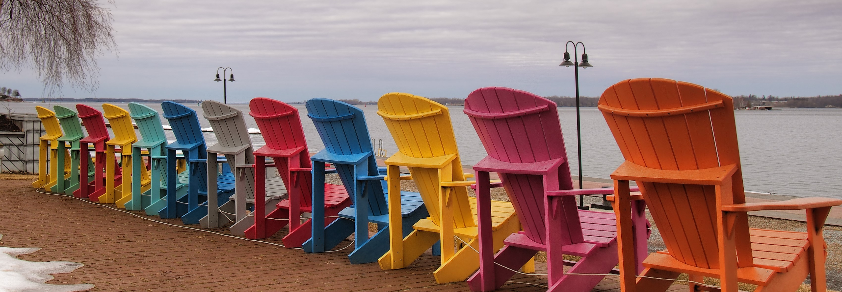
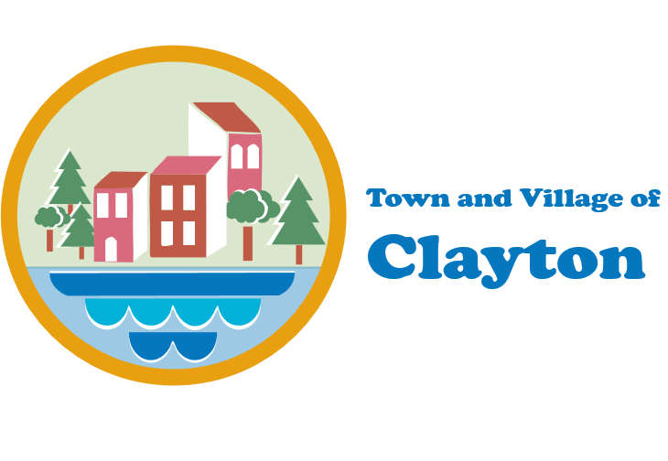

LOCAL WATERFRONT REVITLIZATION PROGRAM (LWRP)
WATERFRONT ADVISORY COMMITTEE (WAC)
MEETING #3
March 11, 2026
Virtual (via Zoom)

Slide 2

This document was prepared with funding provided by the New York State Department of State under Title 11 of the Environmental Protection Fund.

Slide 3
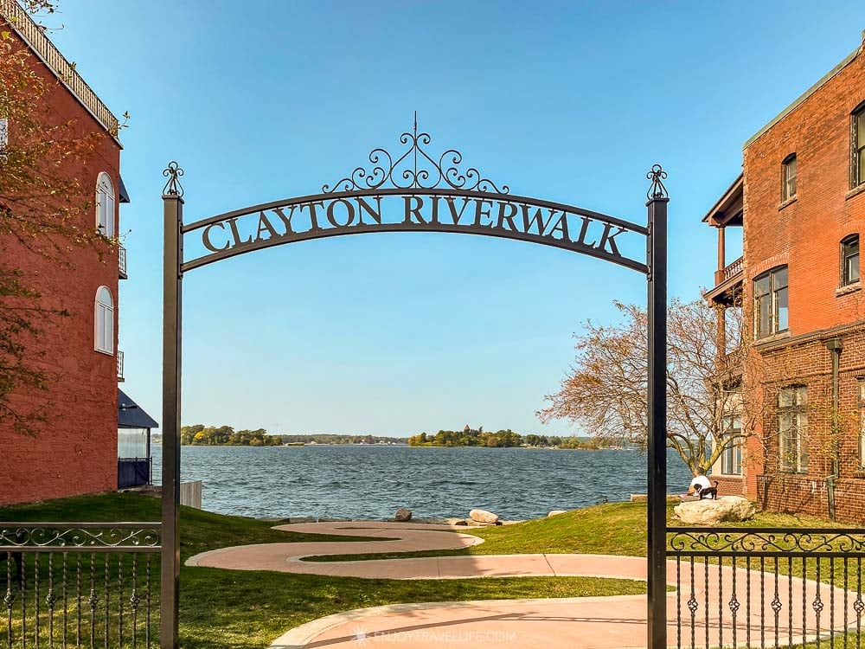
Agenda
01
Welcome
02
Project Schedule Update
03
Public Engagement Update
04
Existing Coastal Management Program Policies
05
Next Steps

Slide 4
Waterfront Advisory Committee (WAC)
Nancy Hyde, Mayor of the Village of Clayton
Kristi Dippel, Clayton Local Development Corp.
Tim Doney, Supervisor of the Town of Clayton
David Powers, Village of Clayton
Dave Wilder, Village of Clayton
Doug Rogers, Joint Planning Board
James Ganter, Clayton Local Development Corp.
Mike Hooson, Clayton Chamber of Commerce
Robert Riddoch, Village of Clayton Trustee
Ron Duford, Village of Clayton Trustee

Slide 5
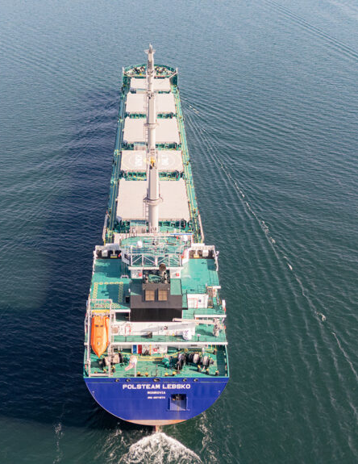

02
Project Schedule Update

Slide 6
Project & LWRP Schedule Update
Stakeholder group meetings
1st Public Information Meeting
Online community survey
Inventory & Analysis
Community Outreach Process & Plan
Proposed land/water uses and projects
Draft LWRP in process
2nd Public Information Meeting
Preliminary Draft LWRP submitted to DOS
DOS Review Process (timing to be determined)
FALL/WINTER 2025
SPRING 2026
SUMMER 2026
FALL/ WINTER 2026/2027
WINTER / SPRING 2026
*WAC Meetings will generally be once every other month (virtual)

Slide 7
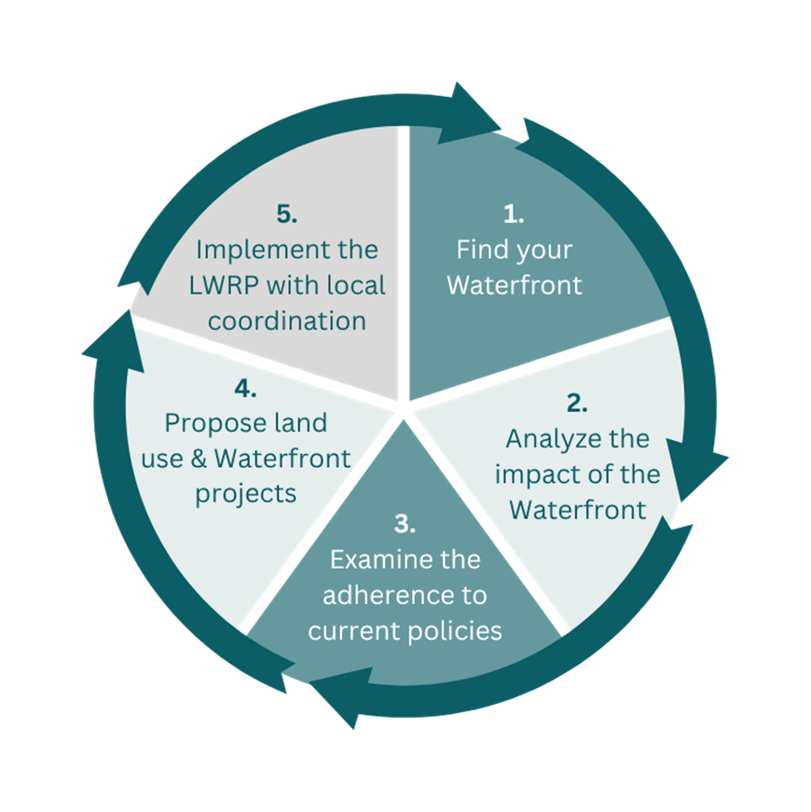
LWRP Program Overview cont.
Circular nature to LWRP; one section helps form the next

Slide 8
☑ LWRP Components
Section 1 – Waterfront Revitalization Area Boundary (Task 7)
Section 2 – Inventory and Analysis (Task 8)
Section 3 – Local Waterfront Revitalization Policies (Task 10)
Section 4 – Proposed Land and Water Uses and Proposed Projects (Task 11)
Section 5 – Techniques for Local Implementation (Task 13)
Section 6 – State and Federal Actions Likely to Affect Implementation (Task 14)
Section 7 – Local Commitment and Consultation (Task 15)

Slide 9
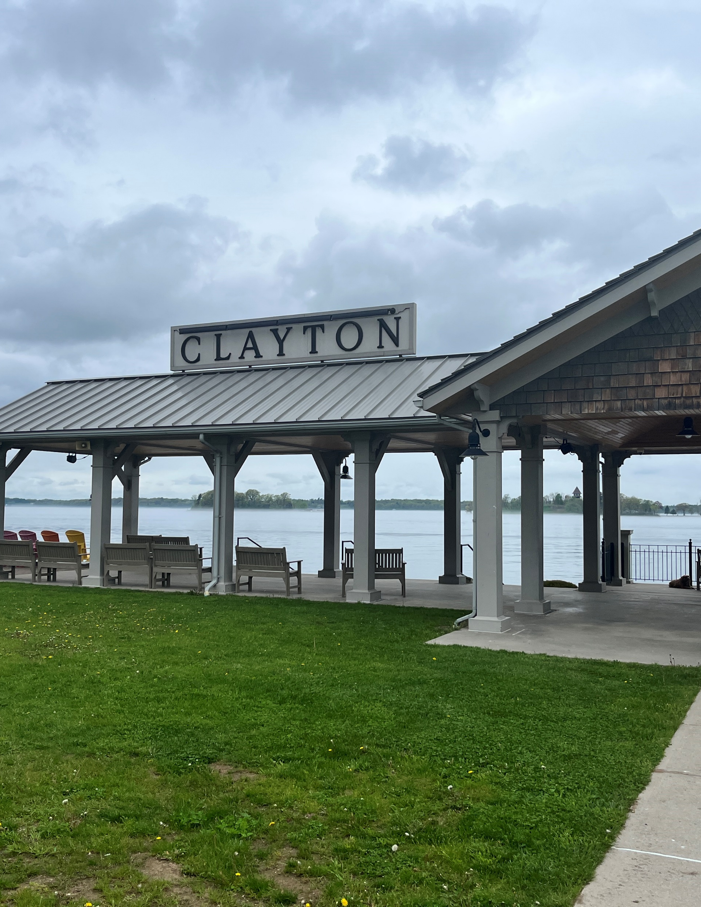
03
Public Engagement Update

Slide 10
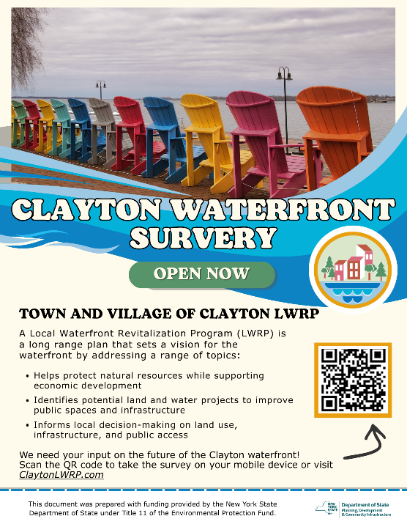
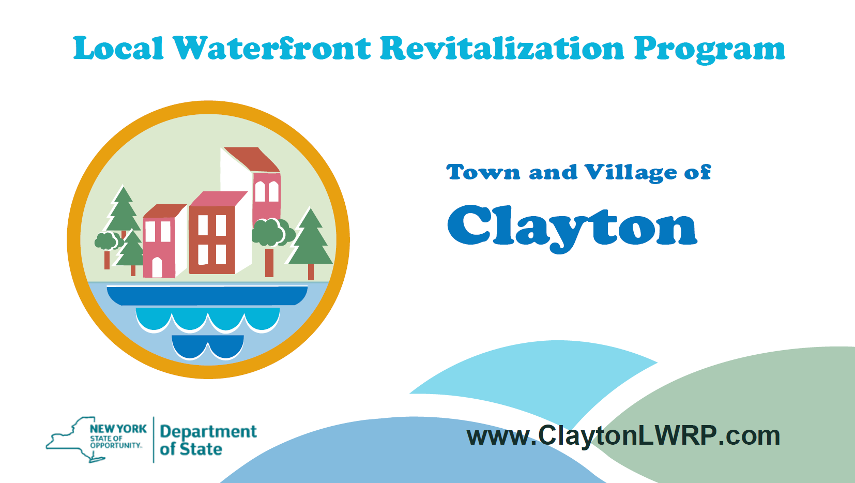
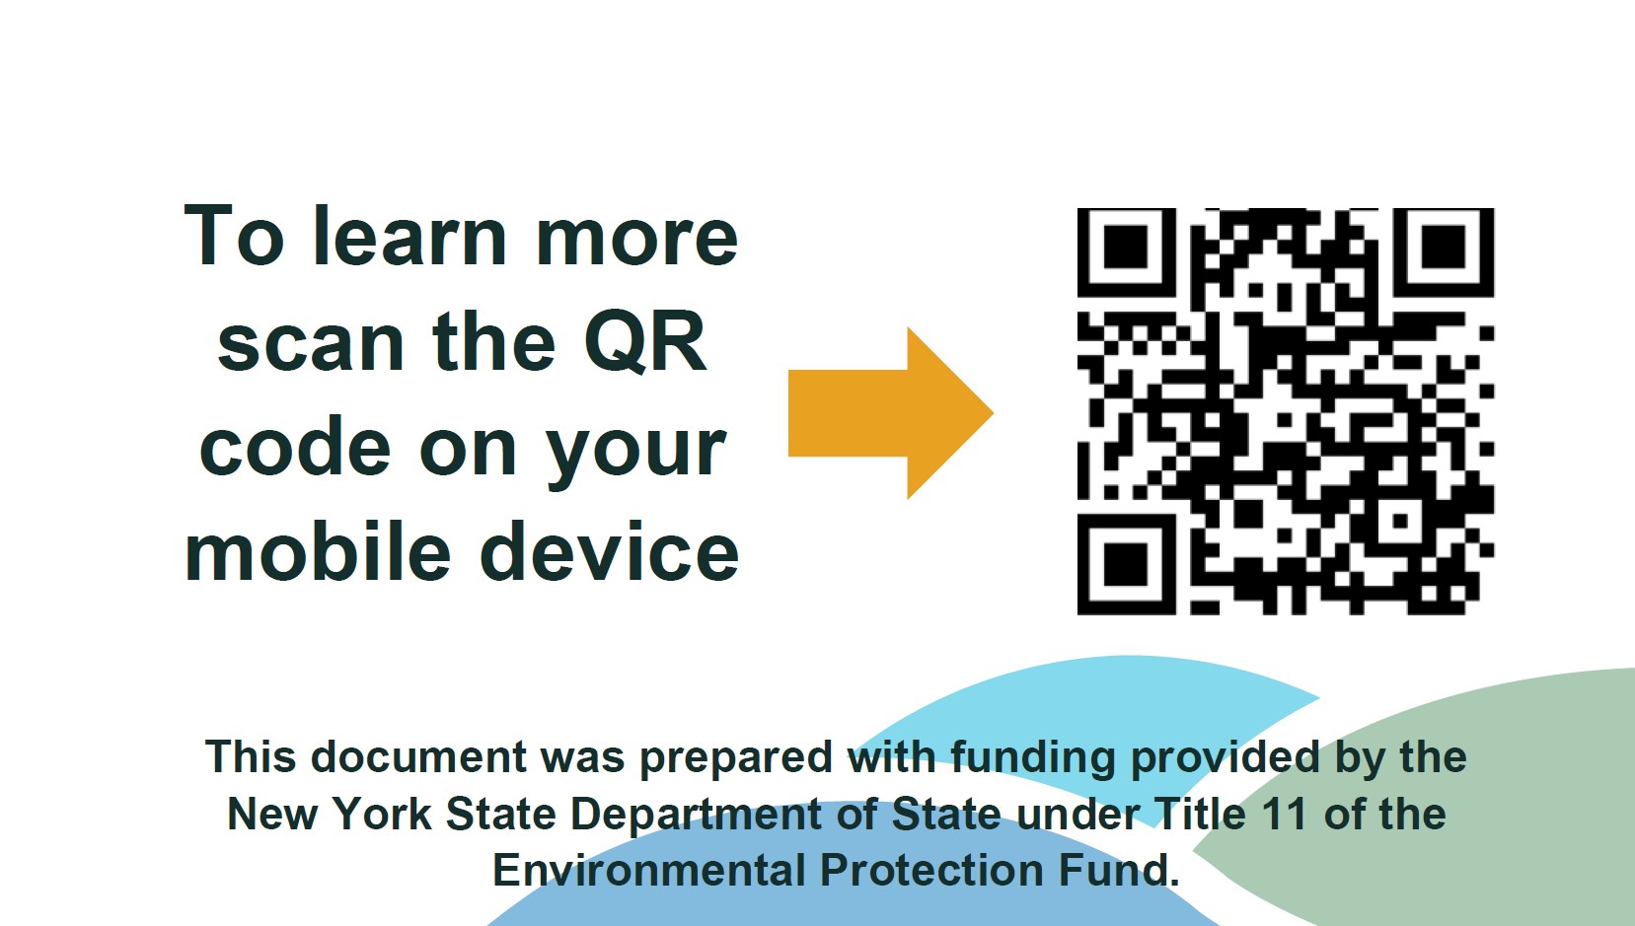
Waterfront Survey (ongoing) Snapshot
Public Engagement Update
Online via Survey Monkey
Opened March 4, 2026
Number of Responses to-date: 200+
Continued publicity methods
  Town Webpage/ social media
  Flyers
  Project Cards

Slide 11
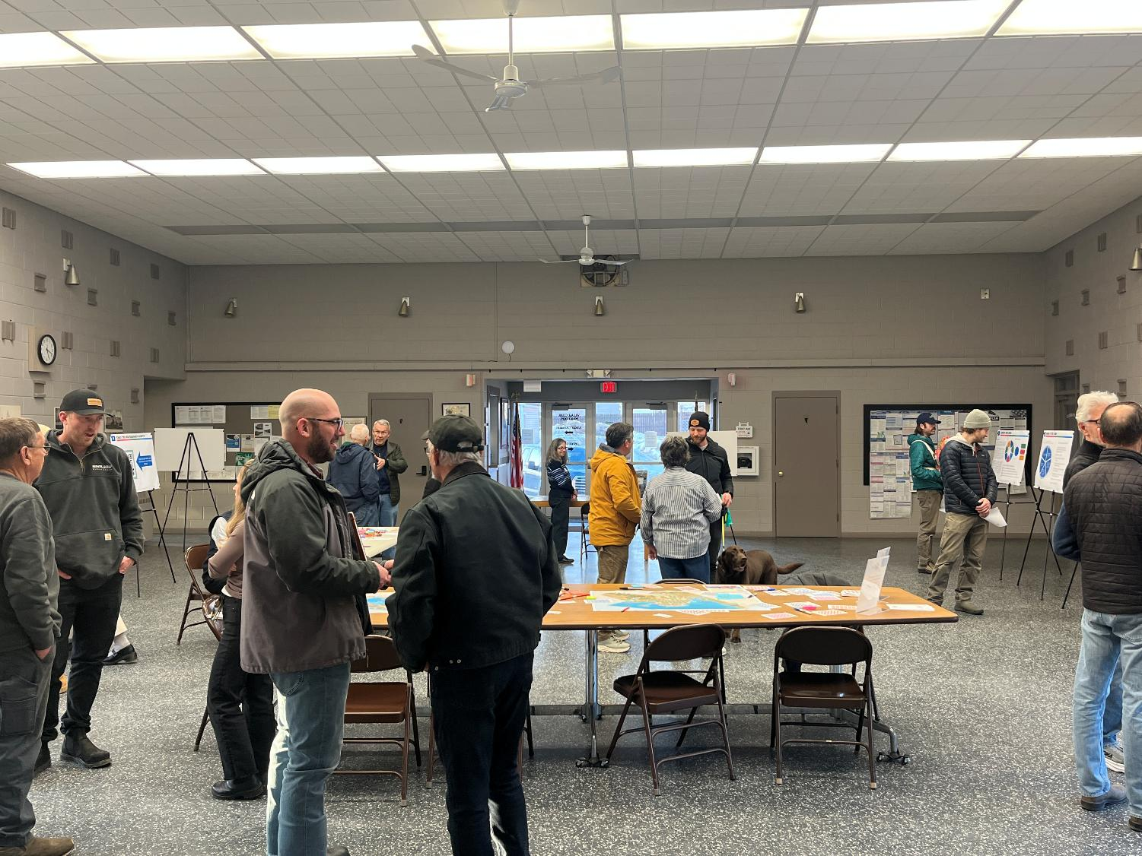
Public Open House Recap
Public Engagement Update
March 4th 4-7 PM – Clayton Municipal Building
Open house style to introduce public to the process and the purpose
Interactive Stations to gather input
  Issues/ Opportunities
  Vision for waterfront

Slide 12
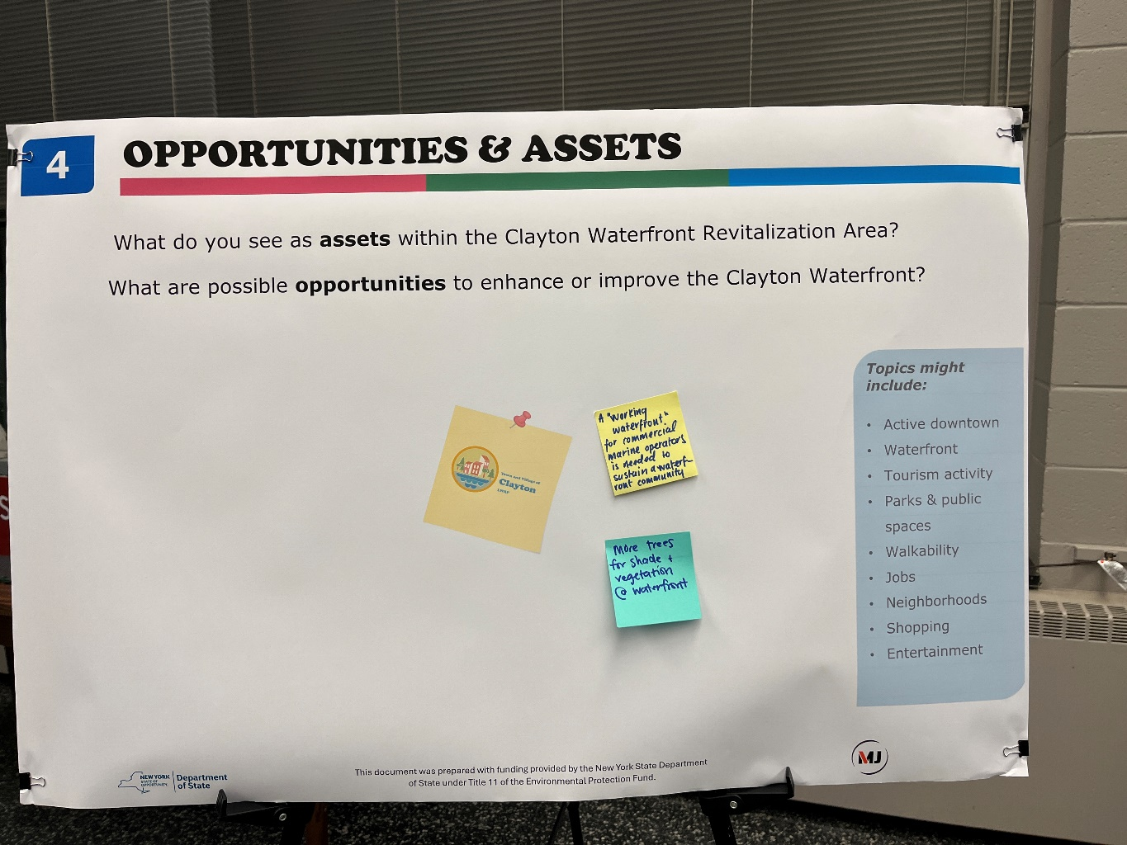
Public Open House Recap
Public Engagement Update
Opportunities & Assets:
A “Working Waterfront” for commercial marine operators is needed to sustain a waterfront community
More trees for shade and vegetation at waterfront
Notes:
Public comment on this board was limited on this board but when they got to mapping station there was more conversation that was captured
This is why we have multiple stations and ways for the public to interact and provide input

Slide 13
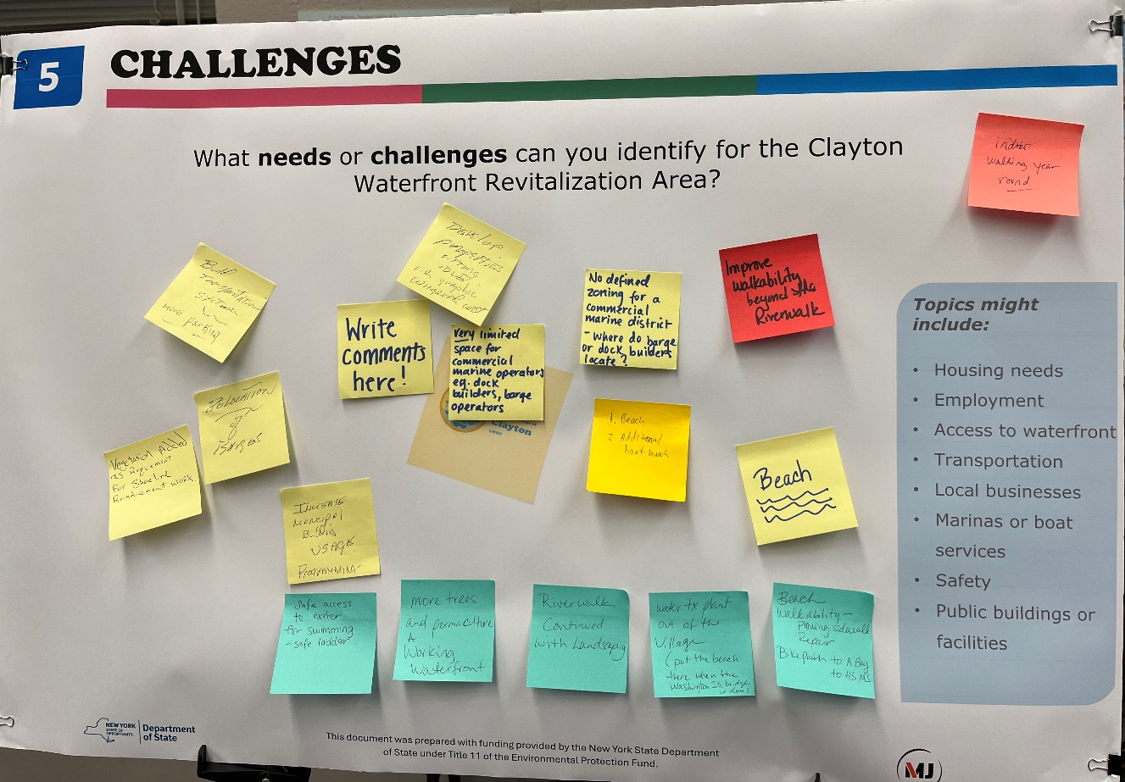
Public Open House Recap
Public Engagement Update
Challenges
Expand walking & biking
Enhance the waterfront
Improve water access & recreation
Support marine industries
Activate underused sites
Improve access & community use
Notes:
Expand walking & biking: Improve walkability beyond the Riverwalk, repair sidewalks, add bike connections, and explore indoor walking options.
Enhance the waterfront: Extend the Riverwalk with landscaping, add trees/vegetation, and support a working waterfront.
Improve water access & recreation: Develop a beach, add a boat launch, and provide safe swimming access.
Support marine industries: Establish zoning and space for commercial marine uses such as dock builders and barge operators.
Activate underused sites: Redevelop idle properties along the waterfront.
Improve access & community use: Consider a transportation hub with parking and increase programming in municipal spaces.

Slide 14
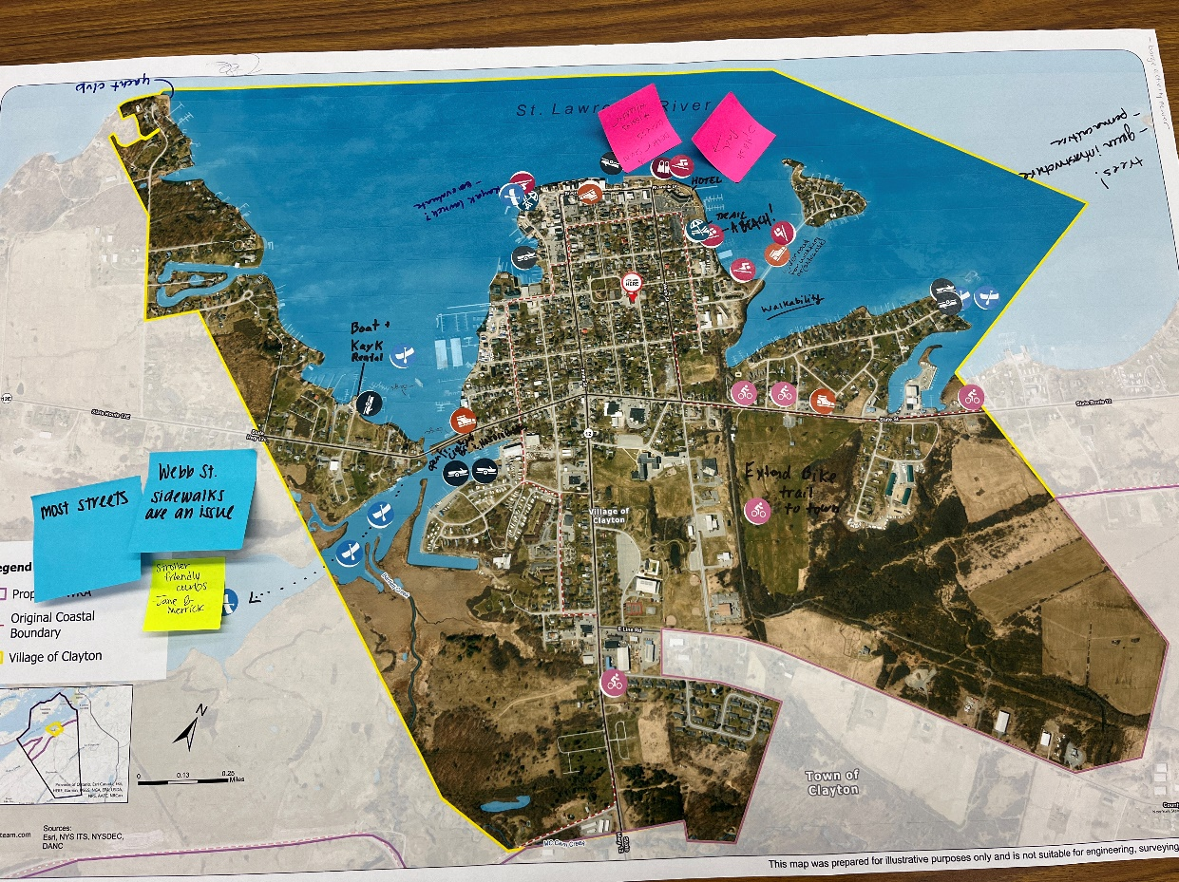
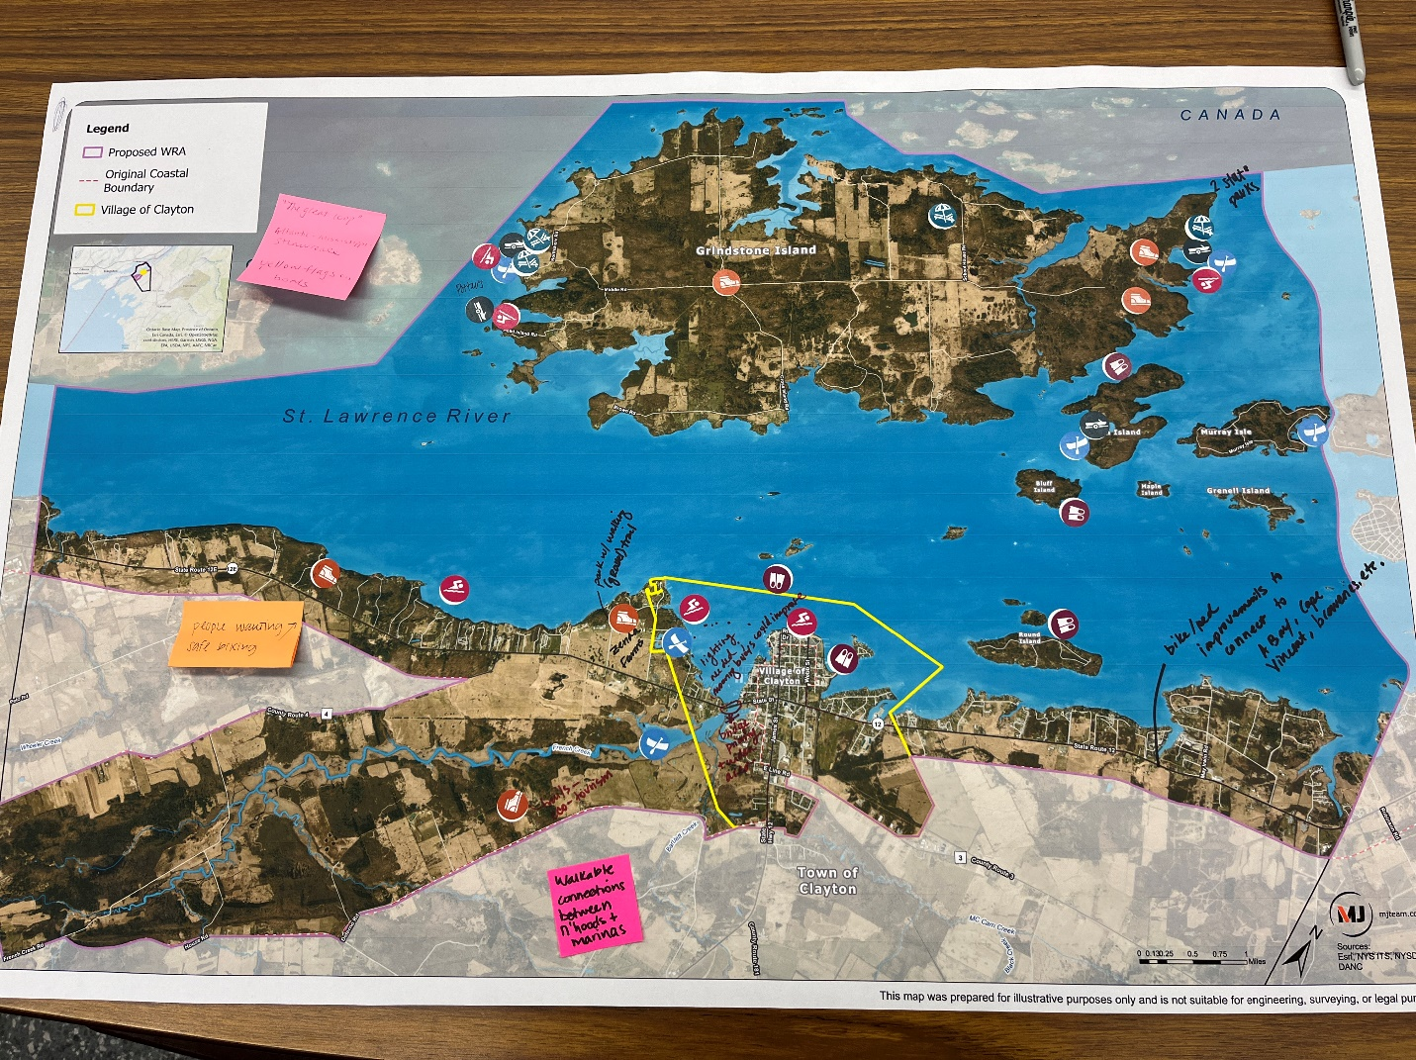
Public Open House Recap
Public Engagement Update
Notes:
People walking and safe biking
Yacht Club
Boat and Kayak rental
Open French Creek bridge
Extend Bike trail to Town
Hotel
Trail, a Beach!
Walkability
Wider road for walkers or (sidewalks)
Trees! Green infrastructure, permaculture
Kayak launch? Evaluate
Splash pad
Better swim access, issue with ladder
Walkable connections between n’hoods + marinas
Trails and ecotourism
Park w/ walking (gravel) trail Zenda Farms
Two state parks
Lighting needed, mooring buoys could be improved
Bridge priority area
Bike/Ped improvements to connect to A Bay, Cape Vincent etc.
Webb St. Sidewalks are an issue

Slide 15
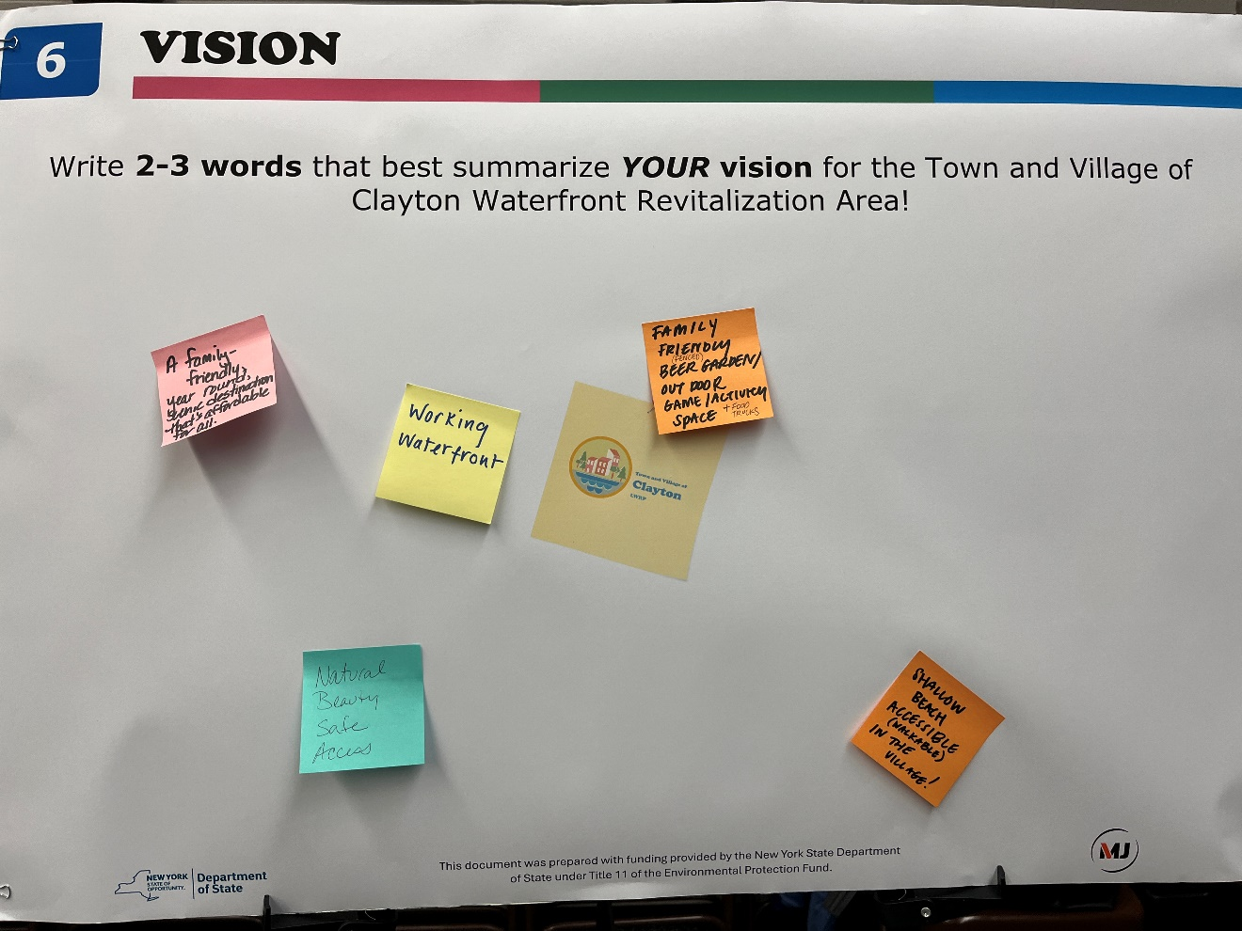
Public Open House Recap
Public Engagement Update
Vision Ideas:
Working waterfront
Family Friendly Beer Garden/Outdoor Game/Activity Space + Food trucks
Shallow Beach Accessible (walkable) in the Village!
Natural, beauty, safe, access
A family-friendly year-round scenic destination that’s affordable for all

Slide 16
Upcoming Stakeholder Group Meetings
Public Engagement Update
5 Groups Identified:
  Environment & Sustainability
  Local and Regional Partners & Community Services
  Local Arts and History Community
  Parks and Recreation
  Economic Development & Business

Slide 17
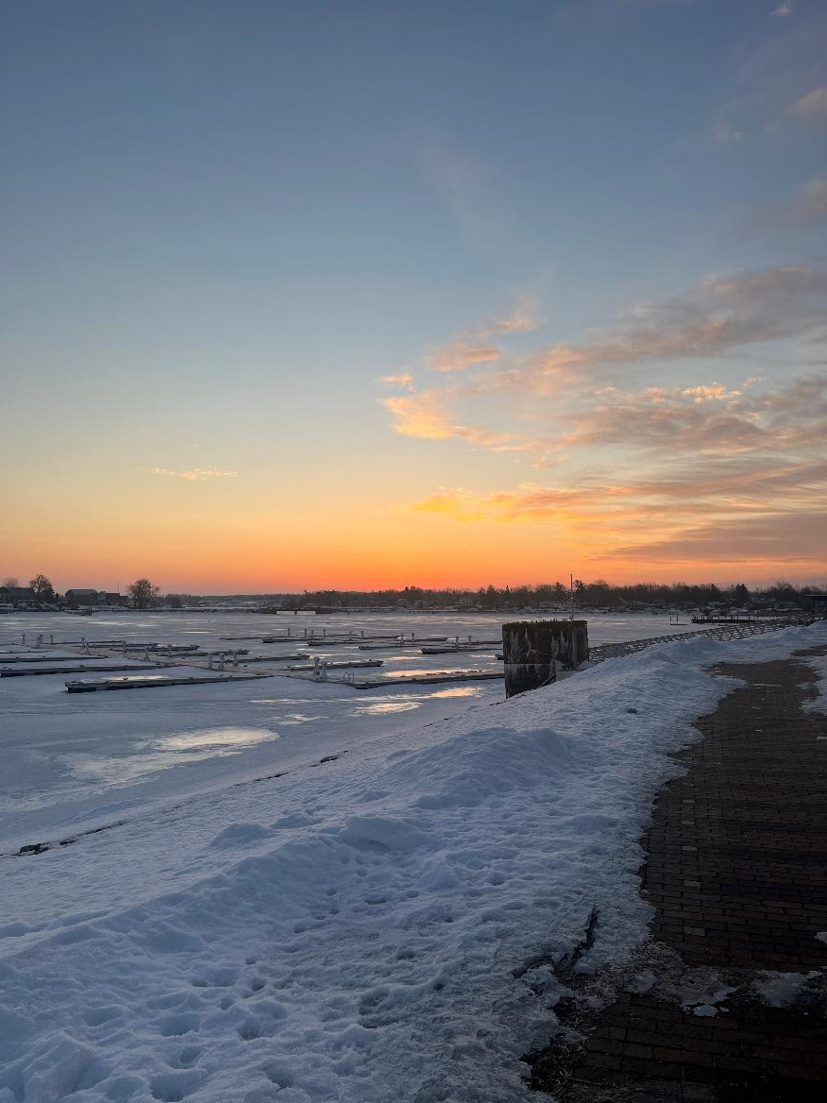
04
Existing Coastal Management Program Policies
(LWRP Section 3)

Slide 18
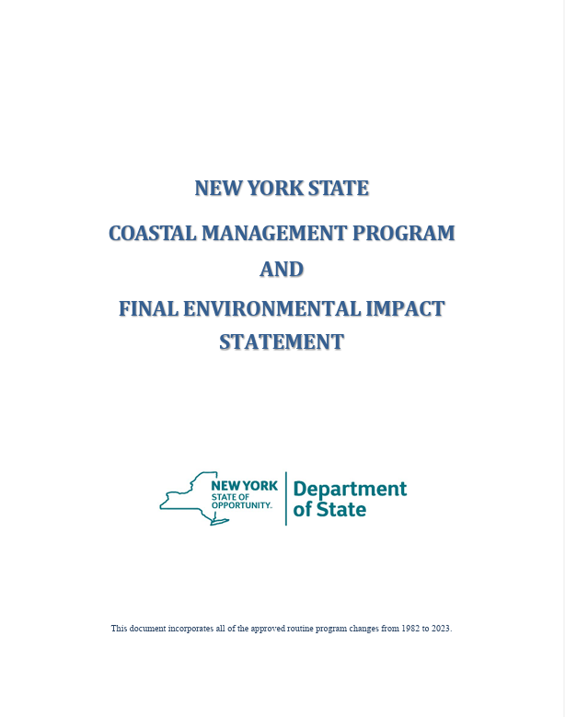
Section 3 – Local Waterfront Revitalization Policies
Coastal Management Policies
What are the Coastal Policies and Where do they come from?
Enforceable statements of law implemented by multiple state laws and regulations
Stated in the NYS Coastal Management Program (CMP)
The CMP incorporates multiple state laws into a set of policies
What’s the goal?
To achieve a balance between preservation and economic development that will permit beneficial uses of and prevent adverse effects on coastal resources
Notes:
The 44 Coastal Policies established by the New York State Department of State guide how waterfront areas are protected, used, and developed – guidance language that advises but does not control
They ensure local decisions align with state coastal management goals and essentially create balance between economic development and the preservation of coastal resources
The existing LWRP has 13 policies, the Coastal Management Program has been updated to include 44 policies for coastal areas like Clayton
Local government is responsible for evaluating proposed actions in the WRA to determine whether local actions, including project approvals, are consistent with the coastal policies and purposes described in the LWRP
Fed and state agencies use the coastal policies in LWRP as basis to determine consistency with the policies when undertaking funding decisions or direct actions for proposed projects and activities located in or having effects within the waterfront area.
Applicants for license, permit or other form of approval must certify consistency with the coastal policies.
Consistency Review undertaken for: Direct actions (Army Corp dredging), Authoritative (Army Corp issuing permit for dock), Funding action (HUD providing funding to local govt)

Slide 19
Section 3 – Local Waterfront Revitalization Policies
Coastal Management Policies
Coastal Management Program Policy Sets
3 Different policy sets
  Coastal communities (44 policies)
  Long Island Sound communities (13 policies)
  Inland waterway communities (revised 44 policies)
Coastal policies cannot be changed
Policy explanations can be refined to reflect local waterfront characteristics, if needed
Notes:
Keep state language, LWRPS may include language that adds to the explanation from the NYS Coastal Management Program or explains why the policy is not applicable at this time (place after state policy)
In limited cases, can add sub-policies – policies are meant to be general and cover broad range (guidance, not rigid rules)
Any added language should reflect local needs & conditions in the waterfront area – example: geographic area of focus, revitalization or resiliency opportunity, important natural or cultural resources, specific local guidelines – not repeat Section II but connect to a need identified based on Section II analysis
Any new sub policies add must be implemented by local law
Should NOT include proposed projects (Section IV)
Should NOT include actual text from or references to local legislation (Section V)
Local refinement is important to allow LWRP communities to inform Federal and State agencies decision making

Slide 20
State Coastal Policies – Development Policies
Coastal Management Policies
Policy 1 | Restore, revitalize, and redevelop deteriorated and underutilized waterfront areas for commercial, industrial, cultural, recreational, and other compatible uses.
Policy 2 | Facilitate the siting of water dependent uses and facilities on or adjacent to coastal waters.
Policy 3 | Further develop the State's major ports of Albany, Buffalo, New York, Ogdensburg, and Oswego as centers of commerce and industry, and encourage the siting, in these port areas, including those under the jurisdiction of State public authorities, of land use and development which is essential to, or in support of, the waterborne transportation of cargo and people.
Notes:
These policies are organized around 11 topics – development, fish and wildlife, flooding and erosion, recreation, water and air resources, etc.
Policy 1 - Seeks to promote redevelopment of areas that have a previous history of waterfront usage – Clayton example of Frink America Property – now Harbor Hotel
Policy 2 – limited waterfront space so prioritizes spaces for water-dependent uses and facilities (marina, shipping facilities)
Policy 3 – related to port authority – no port in clayton wra

Slide 21
State Coastal Policies – Development Policies
Coastal Management Policies
Policy 4 | Strengthen the economic base of smaller harbor areas by encouraging the development and enhancement of those traditional uses and activities which have provided such areas with their unique maritime identity.
Policy 5 | Encourage the location of development in areas where public services and facilities essential to such development are adequate.
Policy 6 | Expedite permit procedures in order to facilitate the siting of development activities at suitable locations.
Notes:
Policy 4 – shipbuilding
Policy 5 – development costs $, development should not be sited where public services do not exist
Policy 6 - Government agencies should try to speed up permit reviews for projects that are proposed in locations where development is appropriate.

Slide 22
State Coastal Policies – Fish & Wildlife Policies
Coastal Management Policies
Policy 7 | Significant coastal fish and wildlife habitats will be protected, preserved, and where practical, restored so as to maintain their viability as habitats.
Policy 8 | Protect fish and wildlife resources in the coastal area from the introduction of hazardous wastes and other pollutants which bio-accumulate in the food chain or which cause significant sublethal or lethal effect on those resources.
Policy 9 | Expand recreational use of fish and wildlife resources in coastal areas by increasing access to existing resources, supplementing existing stocks, and developing new resources.
Policy 10 | Further develop commercial finfish, shellfish, and crustacean resources in the coastal area by encouraging the construction of new, or improvement of existing on-shore commercial fishing facilities, increasing marketing of the State's seafood products, maintaining adequate stocks, and expanding aquaculture facilities.
Notes:
Natural Resource Protection – Protecting wetlands, habitats, water quality, and scenic resources.
As part of Section 2, these habitats will be mapped – i.e. tern colonies on islands in St. Lawrence; French Creek Marsh

Slide 23
State Coastal Policies – Flooding & Erosion Hazard Policies
Coastal Management Policies
Policy 11 | Buildings and other structures will be sited in the coastal area so as to minimize damage to property and the endangering of human lives caused by flooding and erosion.
Policy 12 | Activities or development in the coastal area will be undertaken so as to minimize damage to natural resources and property from flooding and erosion by protecting natural protective features including beaches, dunes, barrier islands and bluffs.
Policy 13 | The construction or reconstruction of erosion protection structures shall be undertaken only if they have a reasonable probability of controlling erosion for at least thirty years as demonstrated in design and construction standards and/or assured maintenance or replacement programs.
Policy 14 | Activities and development, including the construction or reconstruction of erosion protection structures, shall be undertaken so that there will be no measurable increase in erosion or flooding at the site of such activities or development, or at other locations.
Notes:
Policies 11-17 are related to Flooding, Erosion & Resilience – Reducing risk from flooding, storms, and shoreline erosion; Prioritizes natural protective features for shorelines over structures
Policy 11- don’t proposed buildings or projects in areas vulnerable to flooding and erosion where it will be damaged or someone may be harmed
Policy 13 – when public money is spent (for any type of project anywhere) there should be a cost-benefit analysis showing that the benefit outweighs the cost
Policy 14 – ex. Bridge that causes upstream flooding because of design

Slide 24
State Coastal Policies – Flooding & Erosion Hazard Policies
Coastal Management Policies
Policy 15 | Mining, excavation or dredging in coastal waters shall not significantly interfere with the natural coastal processes which supply beach materials to land adjacent to such waters and shall be undertaken in a manner which will not cause an increase in erosion of such land.
Policy 16 | Public funds shall only be used for erosion protective structures where necessary to protect human life, and new development which requires a location within or adjacent to an erosion hazard area to be able to function, or existing development; and only where the public benefits outweigh the long term monetary and other costs including the potential for increasing erosion and adverse effects on natural protective features.
Policy 17 | Non-structural measures to minimize damage to natural resources and property from flooding and erosion shall be used whenever possible.
Notes:
Policy 16 – again, projects using public money should demonstrate
Policy 17 – natural measures before structural

Slide 25
State Coastal Policies – General Policy and Public Access Policies
Coastal Management Policies
General Policy
Policy 18 | To safeguard the vital economic, social and environmental interests of the State and of its citizens, proposed major actions in the coastal area must give full consideration to those interests, and to the safeguards which the State has established to protect valuable coastal resource areas.
Public Access Policies
Policy 19 | Protect, maintain, and increase the level and types of access to public water related recreation resources and facilities.
Policy 20 | Access to the publicly-owned foreshore and to lands immediately adjacent to the foreshore or the water's edge that are publicly-owned shall be provided and it shall be provided in a manner compatible with adjoining uses.
Notes:
Policy 18 - When someone proposes a major project along the coast, decision-makers must carefully evaluate how it affects the economy, communities, and natural environment, and make sure the project follows the protections the State has established for coastal resources.
Policy 20 - If the government owns land along the water, the public should be able to get to it—but the access should be designed so it fits well with neighboring properties and uses – i.e. if there is public property next to a private residence, access might include a small viewing platform or path like the Riverwalk, not a large public beach

Slide 26
State Coastal Policies – Recreation Policies
Coastal Management Policies
Policy 21 | Water dependent and water enhanced recreation will be encouraged and facilitated and will be given priority over non-water-related uses along the coast.
Policy 22 | Development when located adjacent to the shore will provide for water-related recreation whenever such use is compatible with reasonably anticipated demand for such activities and is compatible with the primary purpose of the development.
Notes:
Water-Dependent Uses – Supporting uses that require waterfront locations (marinas, boating, commercial marine activity).
Policy 22 - Waterfront development should include opportunities for people to enjoy the water when it makes sense and doesn’t interfere with the project’s main purpose. Again, Harbor Hotel is a good example – a hotel on the waterfront that includes a public promenade and docks that support boating recreation

Slide 27
State Coastal Policies – Historic and Scenic Resources Policies & Agricultural Lands Policy
Coastal Management Policies
Historic and Scenic Resources Policies
Policy 23 | Protect, enhance and restore structures, districts, areas or sites that are of significance in the history, architecture, archaeology or culture of the State, its communities, or the Nation.
Policy 24 | Prevent impairment of scenic resources of statewide significance.
Policy 25 | Protect, restore or enhance natural and man-made resources which are not identified as being of statewide significance, but which contribute to the overall scenic quality of the coastal area.
Agricultural Lands Policy
Policy 26 | Conserve and protect agricultural lands in the State’s coastal area
Notes:
Policies 23-25 – Historic resources need to be protected but should consult with SHPO prior to making decision
SASS – a SCFWH level of study on scenic areas – used in specific designated SASS areas
Non-SASS areas – difficult policy to implement without local refinement – a project would need to be out of character for this to be used

Slide 28
State Coastal Policies – Energy & Ice Management Policies
Coastal Management Policies
Policy 27 | Decisions on the siting and construction of major energy facilities in the coastal area will be based on public energy needs, compatibility of such facilities with the environment, and the facility's need for a shorefront location.
Policy 28 | Ice management practices shall not interfere with the production of hydroelectric power, damage significant fish and wildlife and their habitats, or increase shoreline erosion or flooding.
Policy 29 | The development of offshore uses and resources, including renewable energy resources, shall accommodate New York’s long-standing ocean and Great Lakes industries, such as commercial and recreational fishing and maritime commerce, and the ecological functions of habitats important to New York.
Notes:
Policy 29 – about balancing new offshore development – like wind or other uses - with existing industries and environmental protection so that they do not crowd out or damage existing maritime industries (shipping or fishing), recreation, or important fish and wildlife ecosystems

Slide 29
State Coastal Policies – Water and Air Resources Policies
Coastal Management Policies
Policy 30 | Municipal, industrial, and commercial discharge of pollutants, including but not limited to, toxic and hazardous substances, into coastal waters will conform to State and National water quality standards.
Policy 31 | State coastal area policies and management objectives of approved Local Waterfront Revitalization Programs will be considered while reviewing coastal water classifications and while modifying water quality standards; however, those waters already overburdened with contaminants will be recognized as being a development constraint.
Policy 32 | Encourage the use of alternative or innovative sanitary waste systems in small communities where the costs of conventional facilities are unreasonably high, given the size of the existing tax base of these communities.
Notes:
Policies 30 – 42 are related to water and air resources
Policy 31 - “Water quality decisions consider coastal policies and local waterfront plans, and polluted waters may limit future development.”
Policy 32 - This policy encourages smaller communities to use less expensive, modern wastewater solutions instead of building very costly centralized sewer systems when their tax base cannot support the cost. – like a shared septic system for example.

Slide 30
State Coastal Policies – Water and Air Resources Policies
Coastal Management Policies
Policy 33 | Best management practices will be used to ensure the control of stormwater runoff and combined sewer overflows draining into coastal waters.
Policy 34 | Discharge of waste materials into coastal waters from vessels subject to State jurisdiction will be limited so as to protect significant fish and wildlife habitats, recreational areas and water supply areas.
Policy 35 | Dredging and filling in coastal waters and disposal of dredged material will be undertaken in a manner that meets existing State dredging permit requirements, and protects significant fish and wildlife habitats, scenic resources, natural protective features, important agricultural lands, and wetlands.

Slide 31
State Coastal Policies – Water and Air Resources Policies
Coastal Management Policies
Policy 36 | Activities related to the shipment and storage of petroleum and other hazardous materials will be conducted in a manner that will prevent or at least minimize spills into coastal waters; all practicable efforts will be undertaken to expedite the cleanup of such discharges; and restitution for damages will be required when these spills occur.
Policy 37 | Best management practices will be utilized to minimize the non-point discharge of excess nutrients, organics and eroded soils into coastal waters.
Policy 38 | The quality and quantity of surface water and groundwater supplies, will be conserved and protected, particularly where such waters constitute the primary or sole source of water supply
Notes:
Policy 38 - Protect drinking water sources and ensure there is enough clean water for communities

Slide 32
State Coastal Policies – Water and Air Resources Policies
Coastal Management Policies
Policy 39 | The transport, storage, treatment and disposal of solid wastes, particularly hazardous wastes, within coastal areas will be conducted in such a manner so as to protect groundwater and surface water supplies, significant fish and wildlife habitats, recreation areas, important agricultural land, and scenic resources.
Policy 40 | Effluent discharged from major steam electric generating and industrial facilities into coastal waters will not be unduly injurious to fish and wildlife and shall conform to state water quality standards.
Policy 41 | Land use or development in the coastal area will not cause national or State air quality standards to be violated.
Notes:
Policy 40 - Industrial and power plant wastewater must meet water quality rules and not harm aquatic life.

Slide 33
State Coastal Policies – Water and Air Resources Policies & Wetland Policy
Coastal Management Policies
Water and Air Resources Policies
Policy 42 | Coastal management policies will be considered if the State reclassifies land areas pursuant to the prevention of significant deterioration regulations of the Federal Clean Air Act.
Policy 43 | Land use or development in the coastal area must not cause the generation of significant amounts of acid rain precursors: nitrates and sulfates.
Wetland Policy
Policy 44 | Preserve and protect tidal and freshwater wetlands and preserve the benefits derived from these areas.
Notes:
Policy 42 – If the state takes action related to classifying and regulating land uses to comply with Clean Air Act, it must comply with coastal management policies

Slide 34
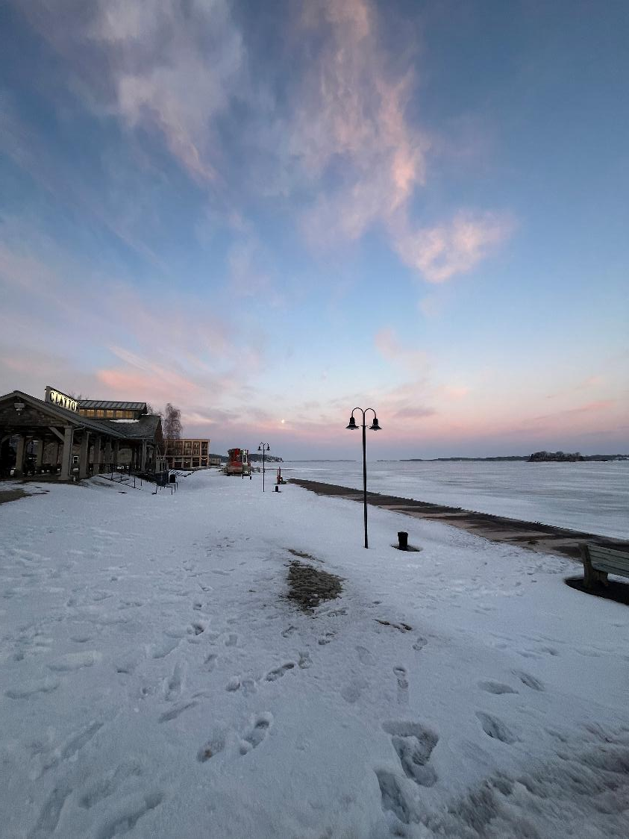
05
Next Steps

Slide 35
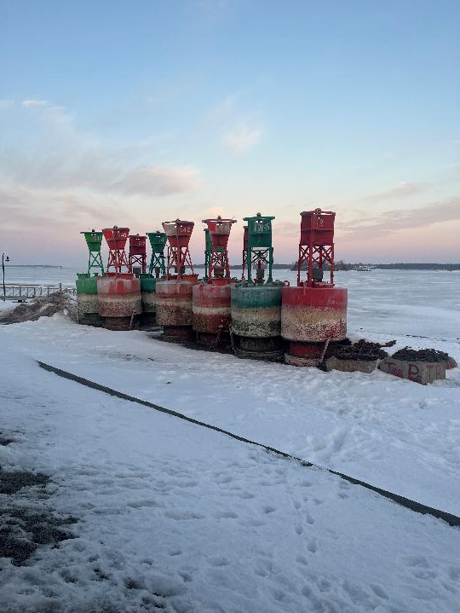
Next Steps
Draft Section 3
Add any needed local refinement to policy explanations
MJ to submit draft to DOS project manager
MJ to submit draft to WAC for review
Section compiled into preliminary Draft LWRP
Notes:
Where might the community want stronger guidance or protections?
i.e. Brookhaven N Shore LWRP – LI Sound with many bays that have water quality issues so those specific bays are noted in policies
WAC role:
Identify priority waterfront issues and opportunities – as we collect public input we will compile and summarize that for the committee to use in identifying issues and opportunities
Ensure the LWRP reflects community values and long-term goals.

Slide 36
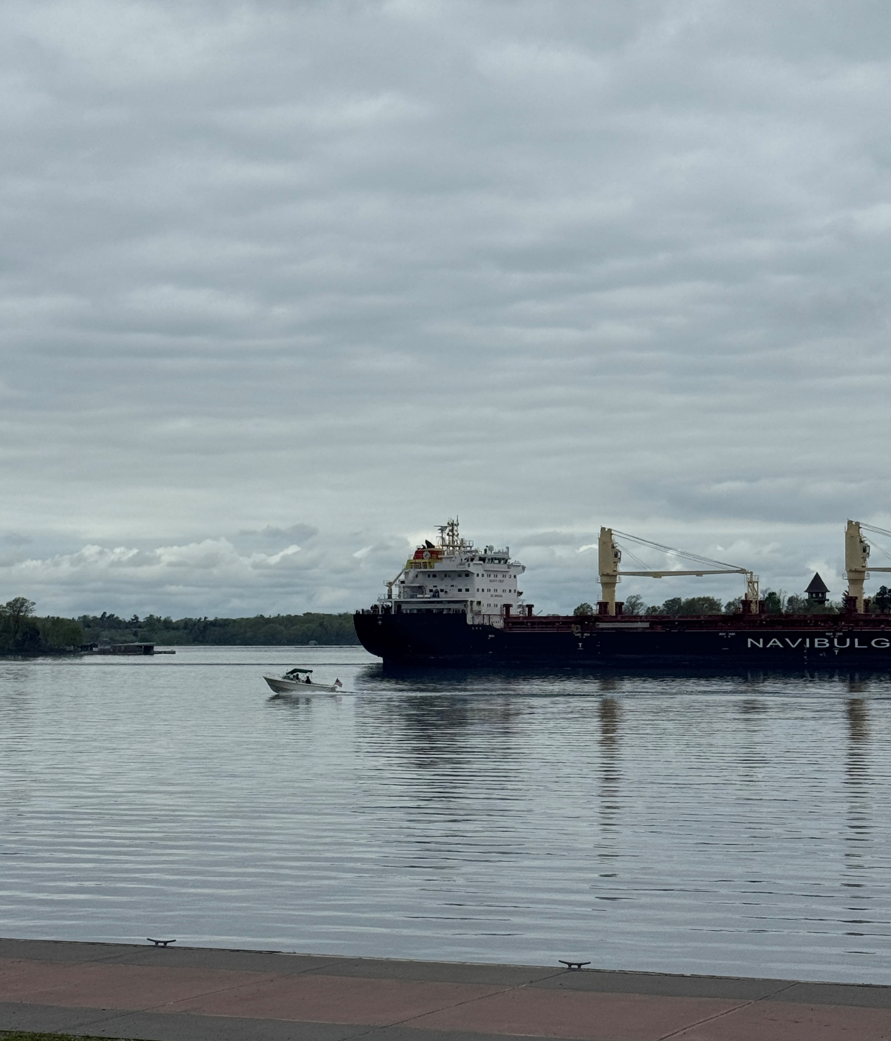
Next Steps
Continue publicizing waterfront survey
Stakeholder Group Meetings – March-April 2026
Next WAC Meeting (virtual) – May 13, 2026
LWRP Project Website: www.claytonlwrp.com
Notes:
Unique visitors to website so far -

Slide 37


Thank you

